Slide 1
Project 1: Kaggle Challenge
Statistical Modeling - House Prices

Slide 2
Table of contents
01
02
03
Project Overview
Methods
Conclusion
1. Data Cleaning
2. Exploratory Data Analysis
3. Data Enrichment
4. Modeling
5. Evaluation

Slide 3
01
Project Overview

Slide 4
Project Overview
The goal of this project is to build a predictive model that can estimate house prices based on a variety of features. We were given the following files:
train.csv | the training set
test.csv | the test set
data_description.txt | full description of each column, originally prepared by Dean De Cock but lightly edited to match the column names used here
sample_submission.csv | a benchmark submission from a linear regression on year and month of sale, lot square footage, and number of bedrooms

Slide 5
02
Methods

Slide 6
Methods
Data Cleaning
Modeling
Evaluation
1.
3.
5.
Handling missing values, removing outliers, and converting categorical variables into factors.
Implementing multiple regression and advanced machine learning techniques such as LASSO, Ridge, and Gradient Boosting.
Using cross-validation and computing RMSE on the log-transformed sale price.
2.
Exploratory Data Analysis
4.
Data Enrichment
Understanding the relationships between features and the target variable (sale price) through visualizations.
Transforming variables, creating new features, and selecting relevant predictors.

Slide 7
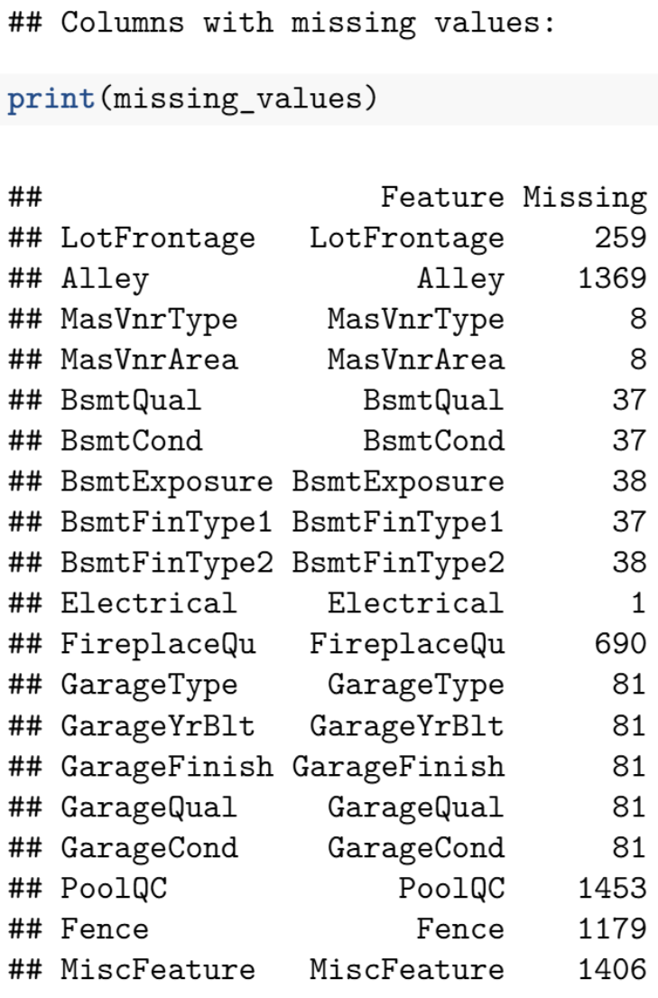
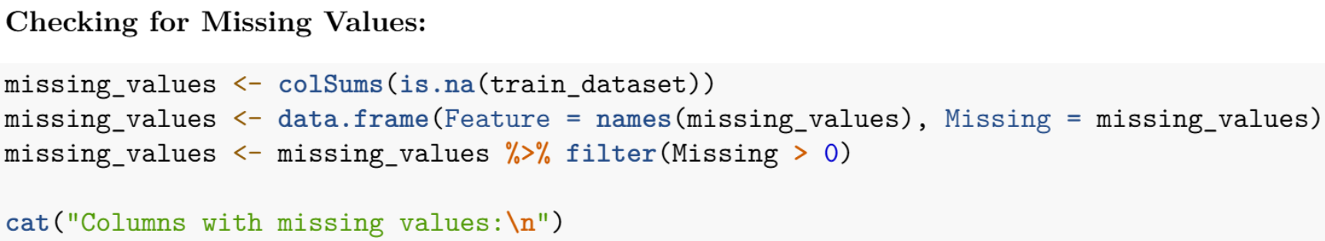
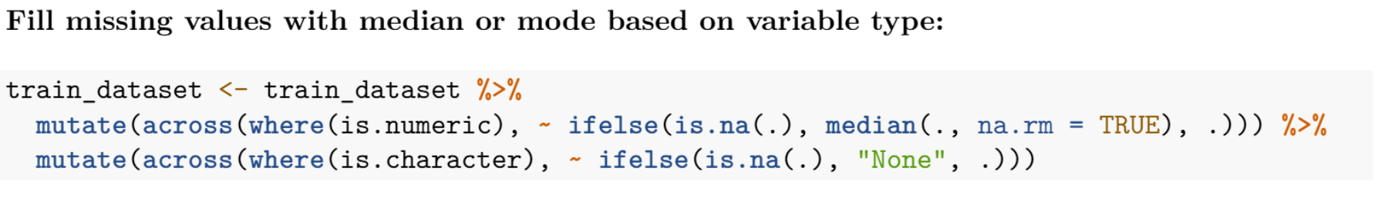
Data Cleaning
For all missing numeric values we give it the median
For all missing character values we give it the value “None”

Slide 8
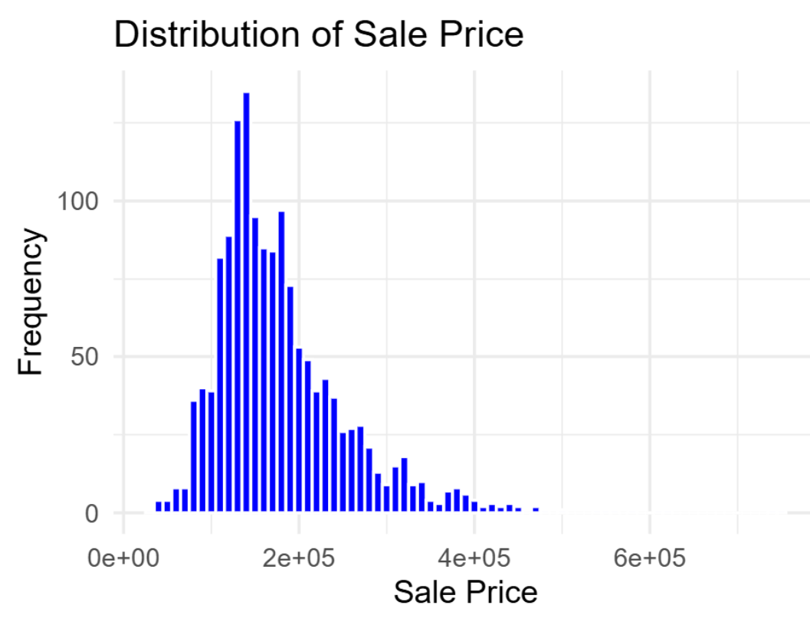
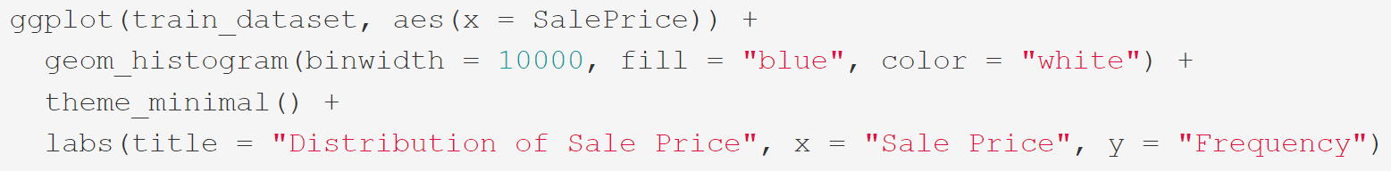
2. Exploratory Data Analysis:
Distribution of SalePrice
Distribution of Sale Price in the Training Dataset
The histogram visualizes the distribution of the "Sale Price" variable from the training dataset. The sale prices are binned with a bin width of $10,000, and the bars are colored blue with a white outline for clarity. The distribution appears to be right-skewed, indicating a concentration of properties at lower price ranges, with fewer high-price properties.

Slide 9
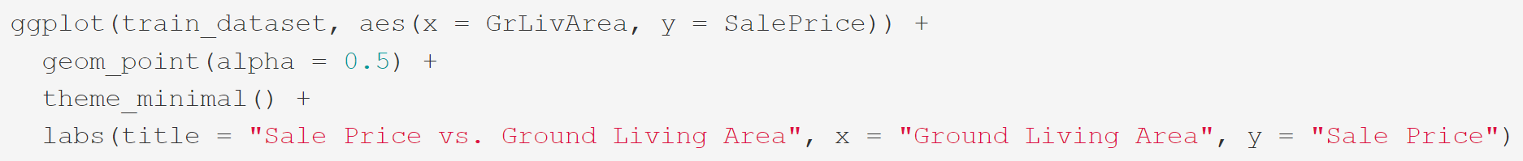
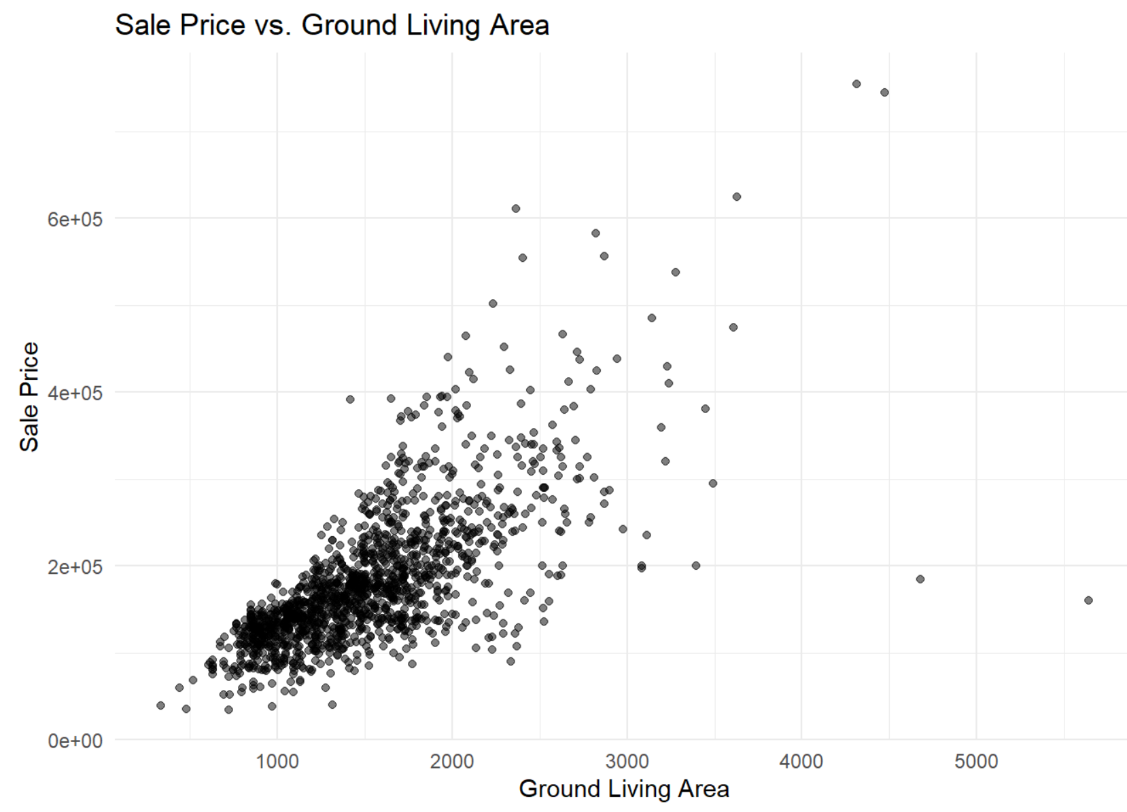
2. Exploratory Data Analysis:
Relationship between GrLivArea and SalePrice
Relationship between Ground Living Area and Sale Price
The scatter plot illustrates the relationship between the "Ground Living Area" (GrLivArea) and the "Sale Price" in the training dataset. Each point represents an individual property. A positive correlation is evident, where larger ground living areas are generally associated with higher sale prices. The transparency (alpha = 0.5) allows for better visualization of point density in overlapping areas.

Slide 10
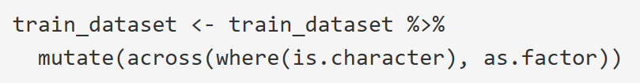
3. Data Enrichment
Log-transforming SalePrice to normalize it:
These data enrichment steps prepare the dataset for more accurate and effective modeling. Log-transforming SalePrice normalizes its distribution, improving model performance. Encoding categorical variables ensures qualitative data is usable, while creating new features like TotalSqFt captures broader patterns and enhances predictive power. Together, these steps improve data quality and align it with model assumptions for better predictions.
Encoding categorical variables:
Creating new features:

Slide 11
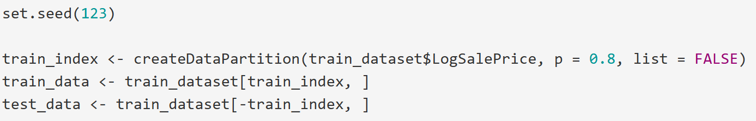
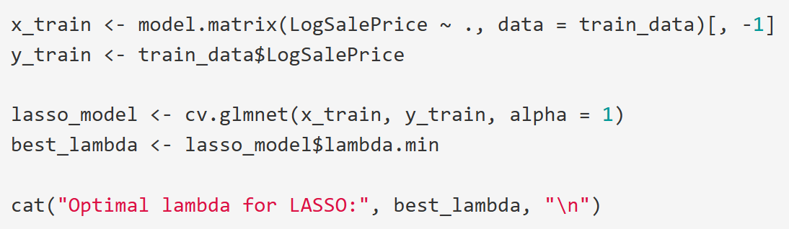
4. Modeling
Split data into training and validation sets:
This process trains a LASSO regression model, which uses regularization to improve prediction and select important features by shrinking less relevant coefficients. The data is split into training and validation sets to ensure generalizability, and cv.glmnet performs cross-validation to find the optimal regularization parameter (lambda = 0.0006191379). This balance prevents overfitting while retaining predictive accuracy, making the model both robust and interpretable.
Fit LASSO Regression:
Optimal lambda for LASSO: 0.0006191379

Slide 12
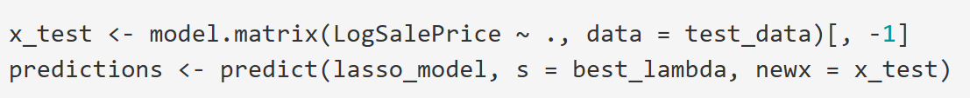
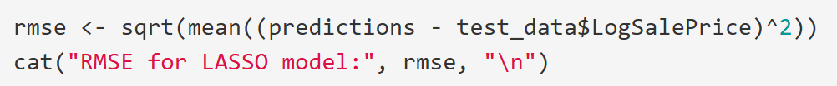
5. Evaluation
Predict on test data
Calculate RSME
RMSE for LASSO model: 0.09044559
This step evaluates the performance of the LASSO regression model on unseen test data. Predictions are generated using the test set and the optimal lambda value identified during training. The model’s accuracy is assessed using the Root Mean Squared Error (RMSE), which measures the average magnitude of prediction errors. An RMSE of 0.0904 indicates that the predicted log-transformed sale prices are close to the actual values, demonstrating the model's effectiveness in generalizing to new data. RMSE provides a clear, interpretable metric to compare the performance of different models or optimization approaches.

Slide 13
03
Conclusion

Slide 14
Conclusion
Dataset Challenges:
Issues with missing values, mixed data types, and the large number of features (81 columns) were addressed systematically.
Approach:
Employed data cleaning, exploratory analysis, and advanced modeling techniques.
Balanced predictive performance with interpretability to create a reliable house price estimation model.
Techniques Used:
LASSO regression for feature selection, reducing complexity while retaining relevance.
Imputation strategies for missing data (LotFrontage and GarageType) to maintain data usability and avoid bias.
Logarithmic transformation of SalePrice to manage heteroscedasticity effectively.
Performance:
The final model achieved a strong predictive performance, with an RMSE of 0.0904 on log-transformed prices.

Slide 15
Thank You!

